Slide 1
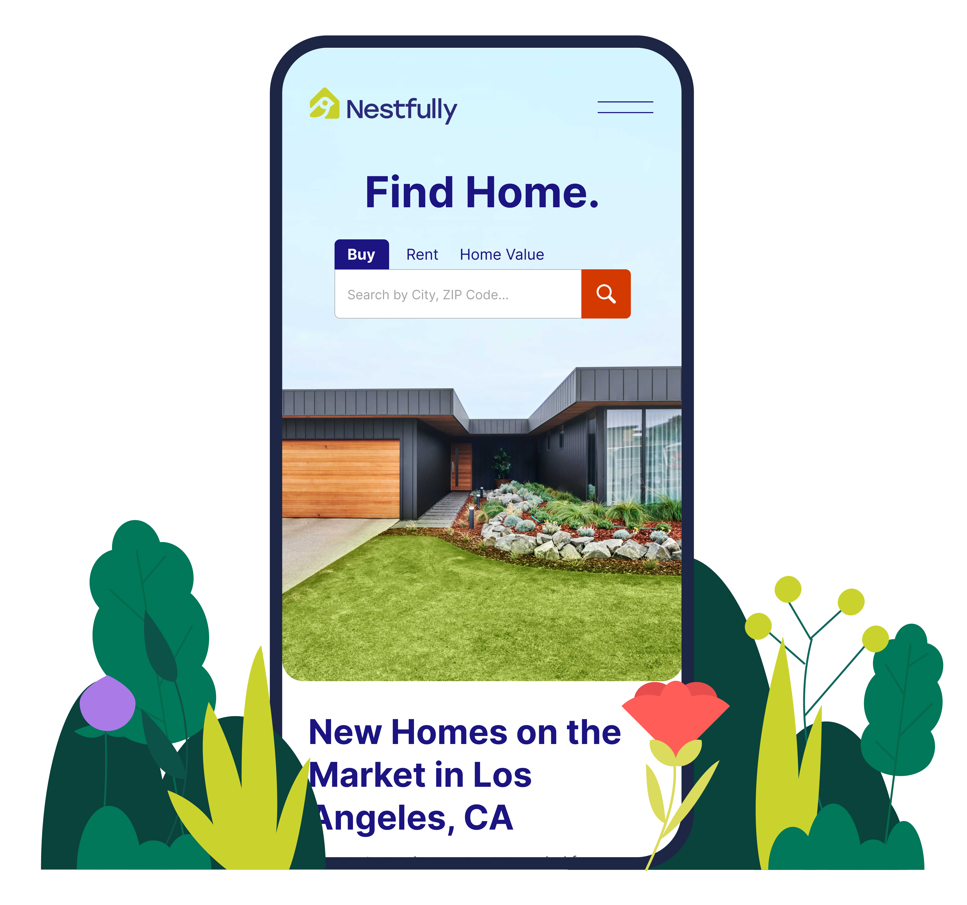

Slide 2
Find a home. Sell a home. Simplify your real estate journey using the same tools as the pros.

Slide 3
Powered by the MLS.
Driven by You.
Nestfully gives you exclusive access to the freshest listings and the most complete and accurate data available, straight from the source used by the pros—the MLS

Slide 4
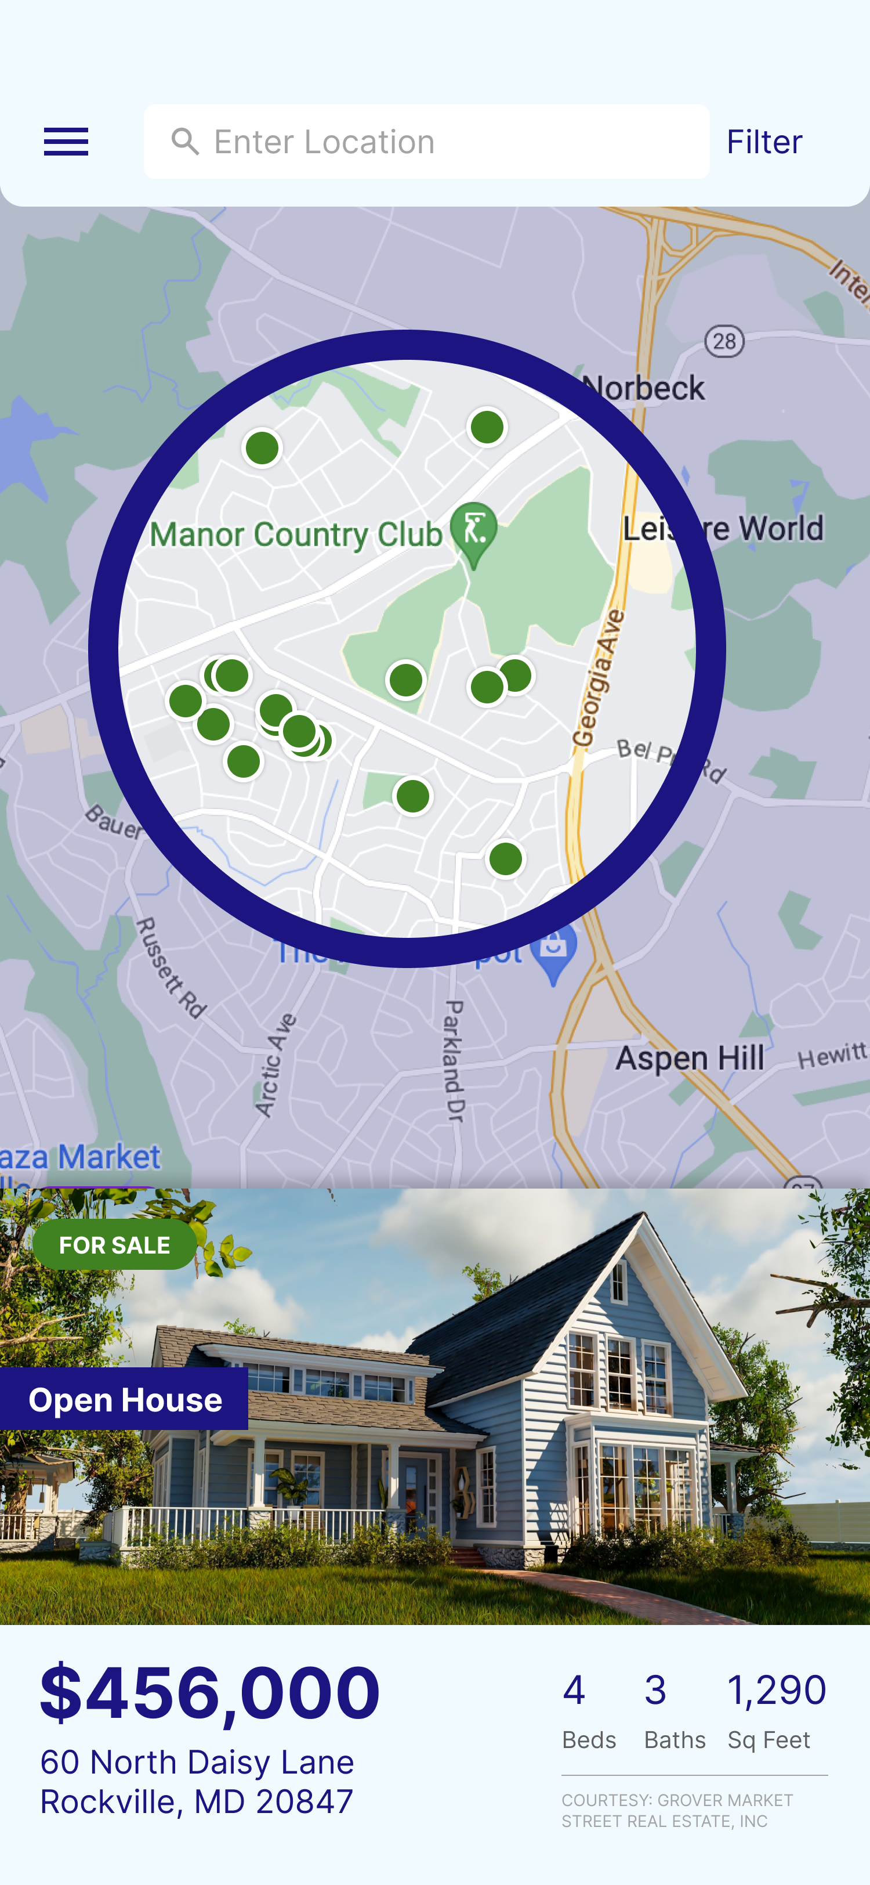
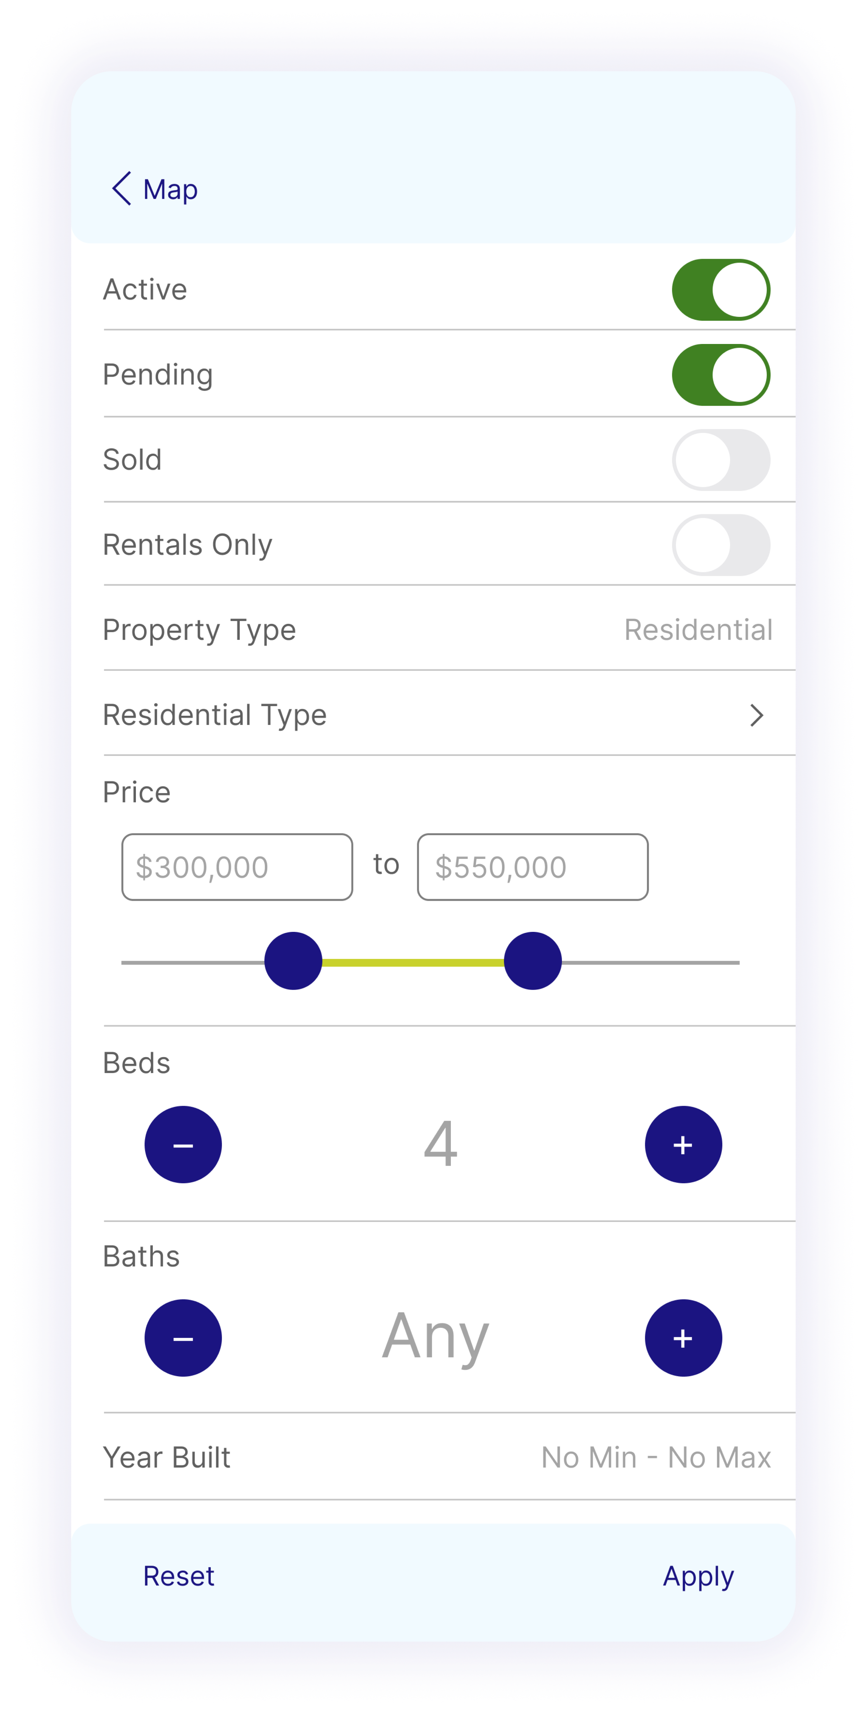
Search Real-Time Listings
Customize your search with tons of filters for tailored results.

Slide 5
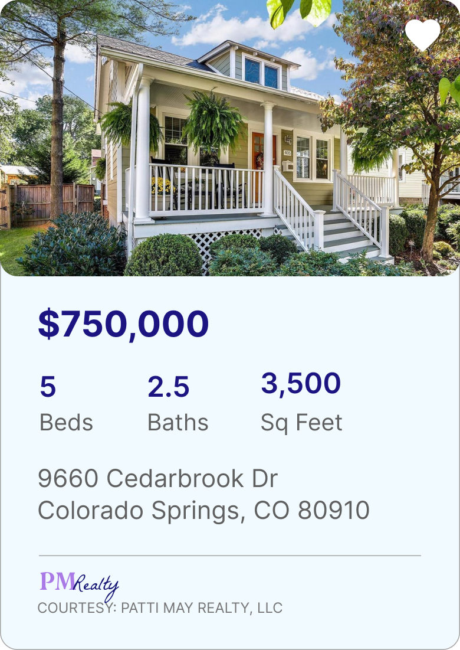
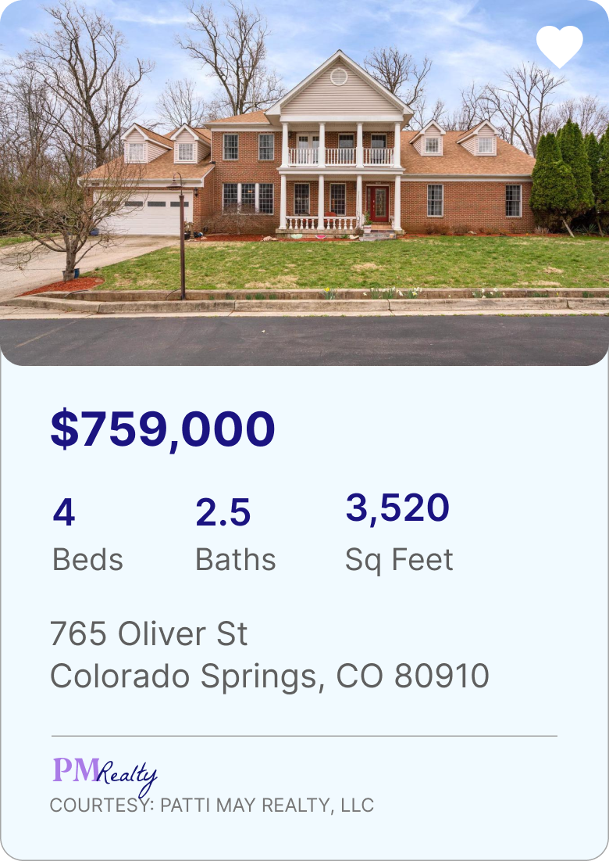
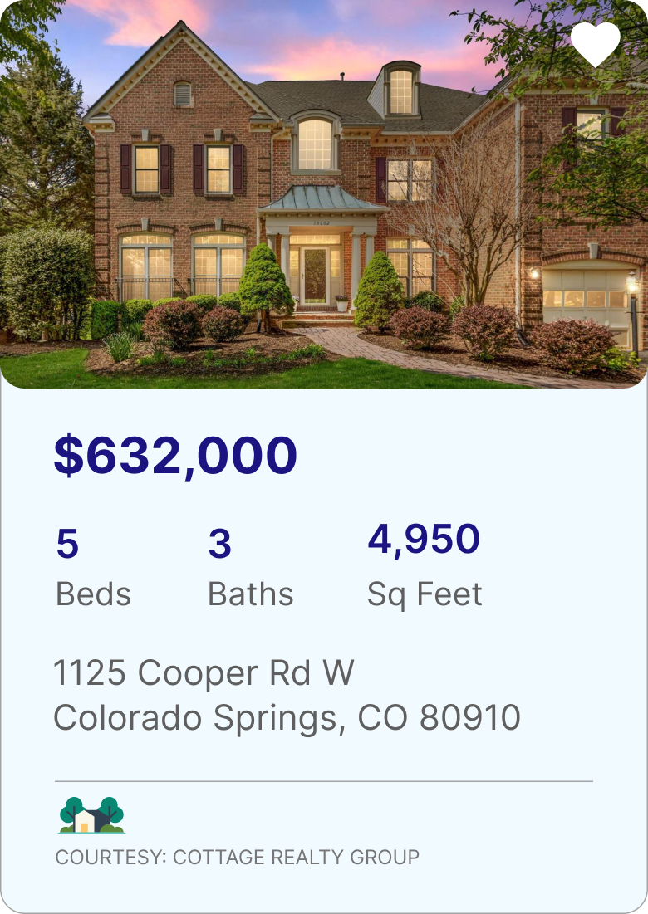
Market Matters
View listing and sale price data in your market of interest to help inform your choices.

Slide 6
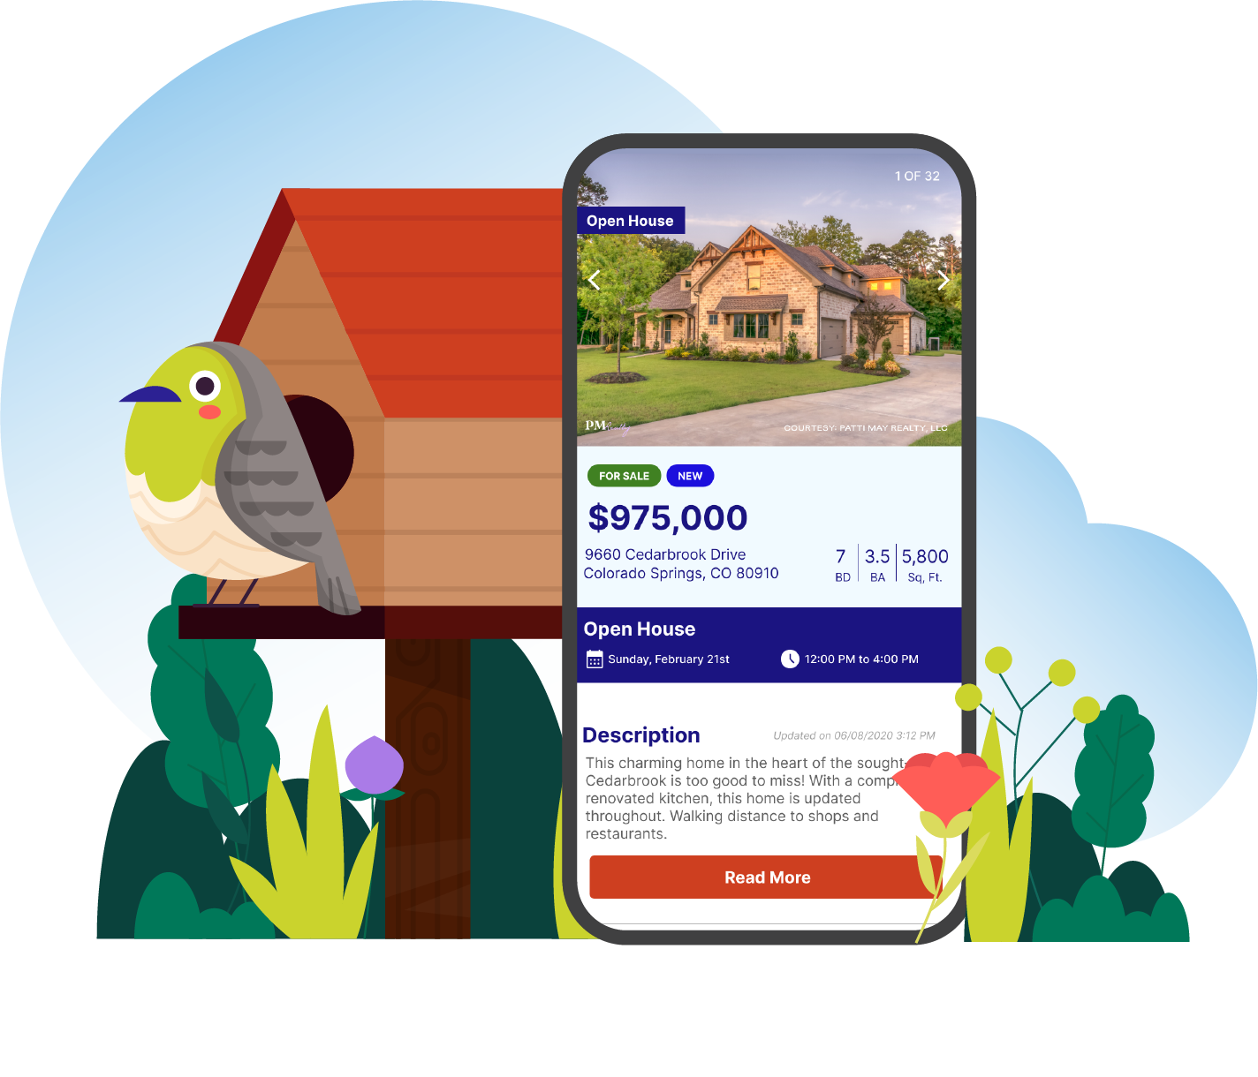
Welcome to the Open Marketplace
The MLS champions fair and equal access to housing for all. Nestfully opens the door to that marketplace and invites you to embark on your best real estate journey ever.

Slide 7
Talk to Your Agent
Your agent is the best resource for market knowledge and real estate expertise. Ask your agent about the many ways Nestfully can simplify your buying, renting, or selling experience.

