Slide 1


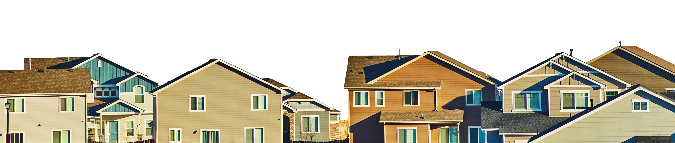
WHY LISTING EXPOSURE MATTERS

Slide 2


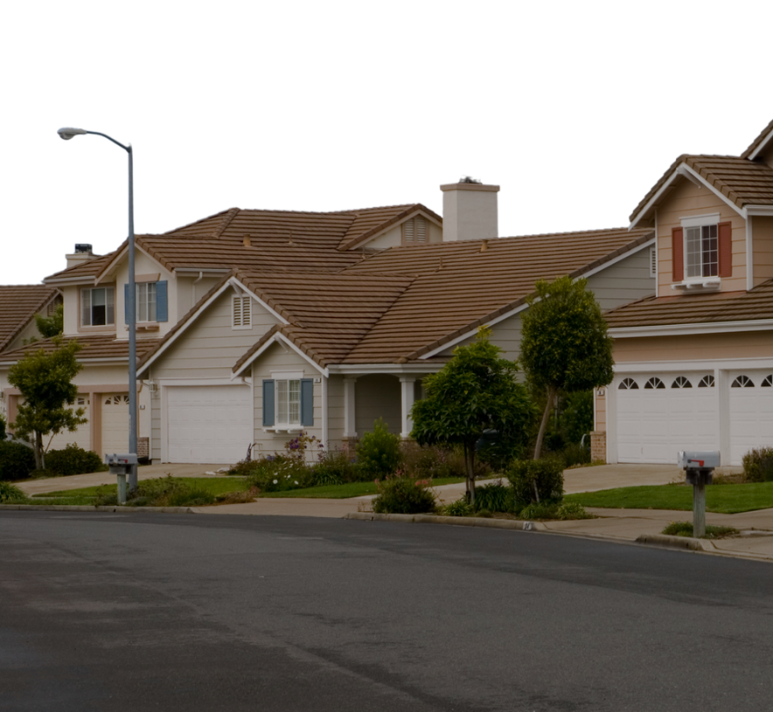
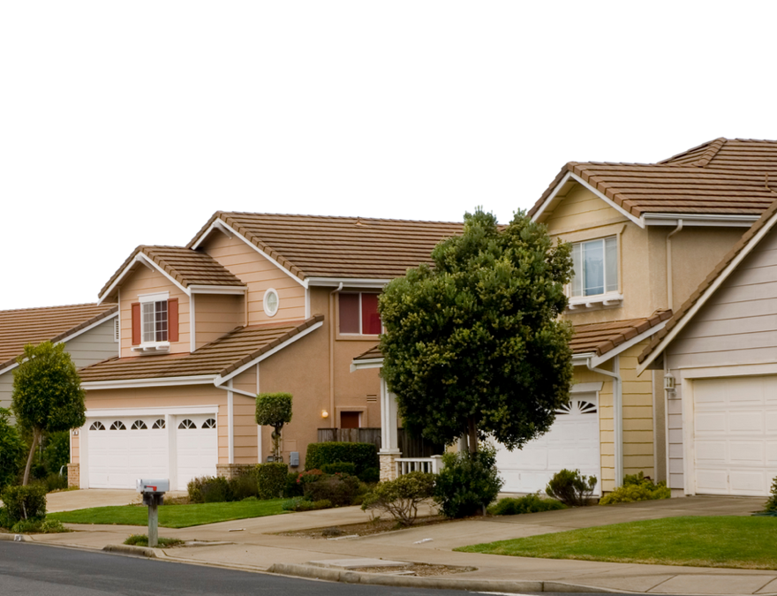
Why Listing Exposure Matters
The multiple listing service (MLS) is one of the most efficient ways to advertise your home. I work with California Regional MLS, the largest and most distinguished MLS in California and second largest in the country, which means your property reaches the most potential buyers possible to ensure you get competitive offers.
When I list your home on the MLS, you get:
  Broader exposure to more home buyers
  Connected with vetted industry professionals
  Circulation across widely popular third party websites
  Customized privacy and security
If you don’t list on the MLS, it comes at a very literal cost. According to Zillow research, homes in California that are sold off-MLS typically go for $30,000 less.
Private listing networks that are unaffiliated with the multiple listing service have been shown to be more vulnerable to fraud and discriminatory practices.
By using CRMLS, I can offer you access to the behind-the-scenes world of the real estate industry.
The math is simple – more exposure for your listing means more money for you. That’s why I use CRMLS to give you the most profitable and safest selling experience possible.

