Slide 1



FIRST-TIME
HOME BUYERS

Slide 2
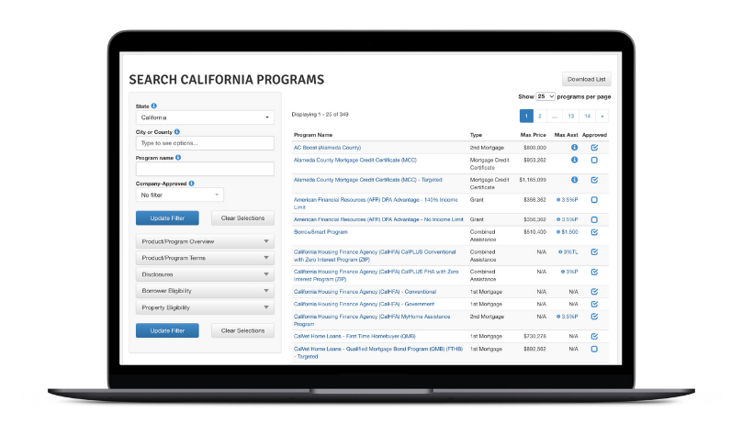
Buying Your First Home? Let’s Make It Easier, Together
As a first-time homebuyer, you are undertaking one of life’s most exciting and biggest milestones. It might very well be the largest amount of money you’ve spent on anything at this point in your life, and it can be tough on anyone. You may not know it, but there are programs you are likely eligible for that can help, specifically with the down payment. As your agent, I can help guide you through the process.
I'm connected to CRMLS, one of the largest and most distinguished MLSs in California, and there are certain advantages only a real estate professional like me can offer to first-time homebuyers.
Get the Down Payment Help You Deserve
My CRMLS connection grants me access to Down Payment Resource® (DPR), which can source state and federal assistance programs and connect you to listings that qualify for down payment assistance. It’s a big part of the value I can offer to your homebuying journey.
Navigating California’s Many Options
According to DPR’s continuous research and reporting, California has by far the widest array of down payment assistance programs and agencies in the country. What’s more, at least 60% of all CRMLS listings are eligible for some form of down payment assistance at any given time.
Programs
348
Agencies
221
Partner with me, and together we’ll make your first home your dream home.
Note: Data as of January 2026

