Slide 1
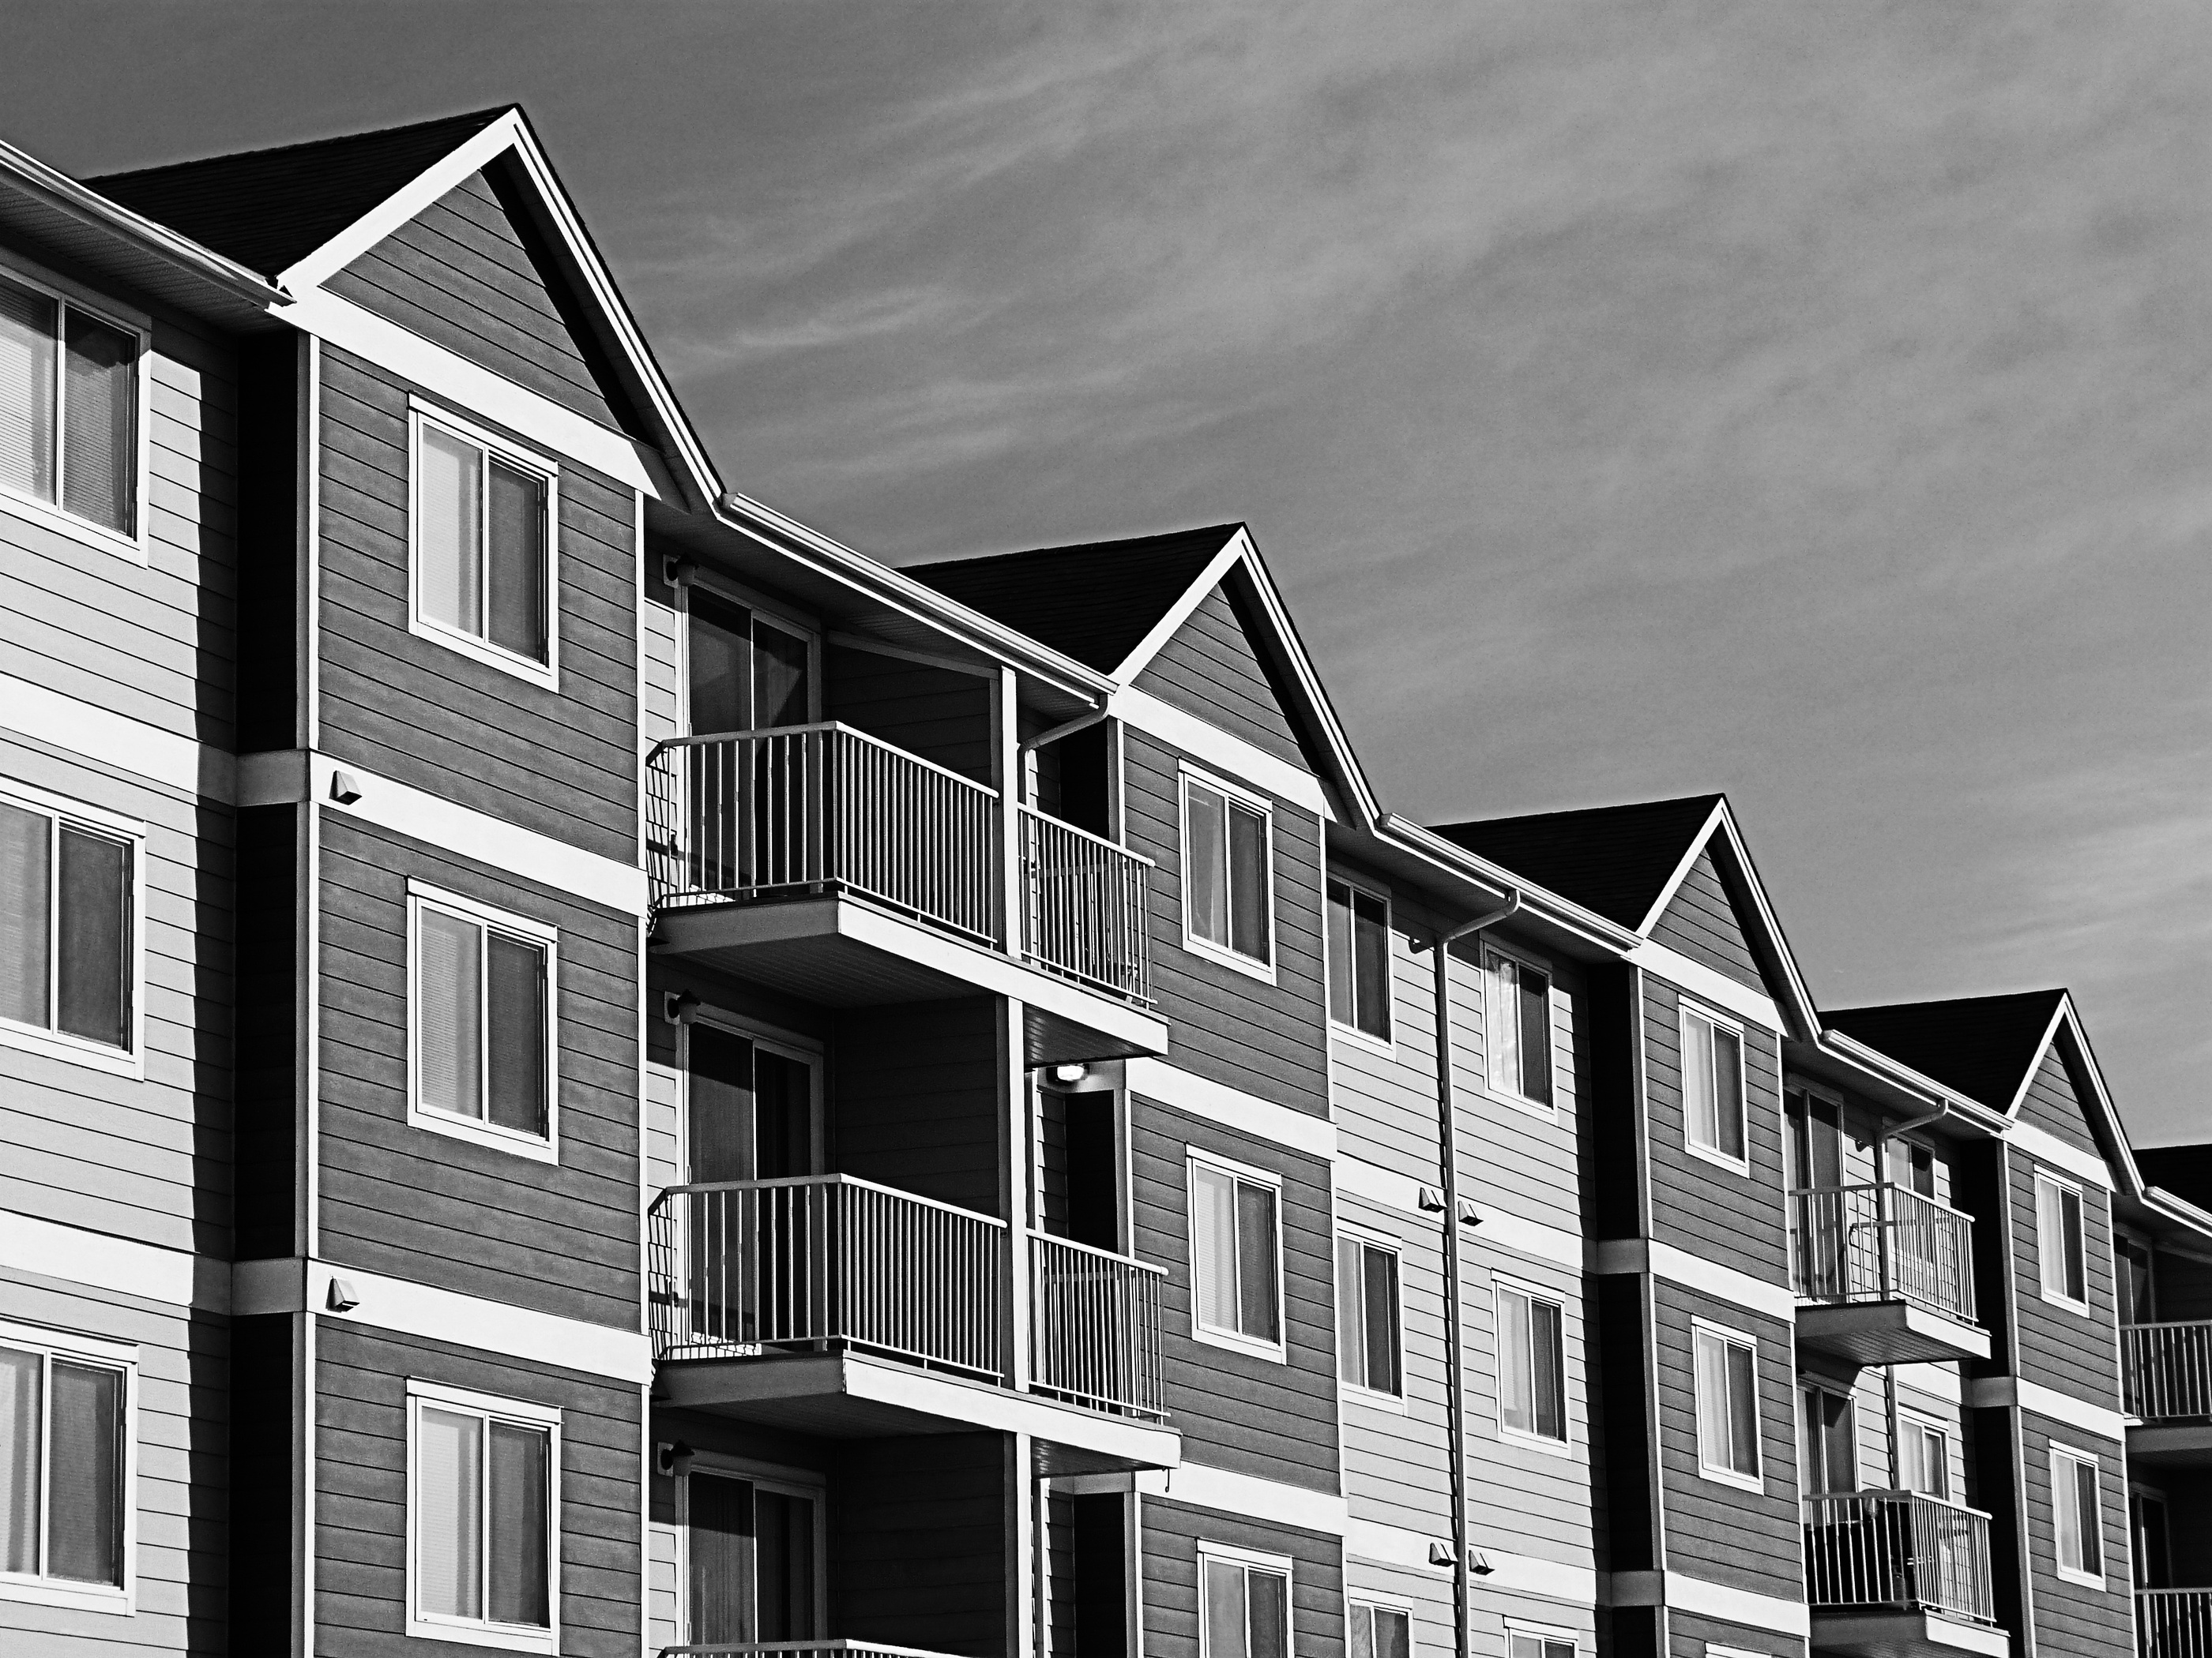


WHY RENTING THROUGH AN MLS-CONNECTED PROFESSIONAL IS THE SAFEST BET

Slide 2
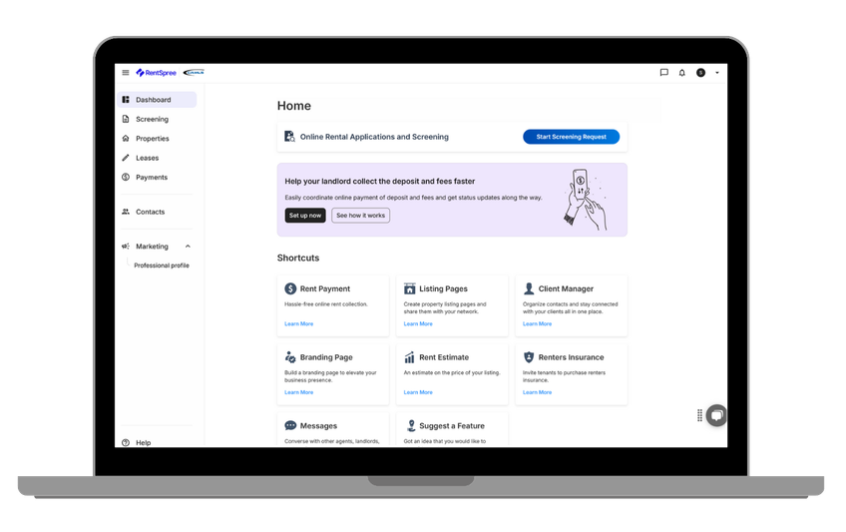
Looking to rent in a new community? Need special features like elevators or pet-friendly policies? Finding the right rental on your own to fit your exact needs can be daunting and time-consuming. That’s where I come in.
As your agent, I work with California Regional MLS, one of the largest and most distinguished multiple listing services in the country, gaining access to listing information that’s not available to the general public. I’m connected to an extensive network of brokerages full of verified rental listings so I can protect your rights and interests while saving you hassle.
How I Simplify Your Rental Journey:
  Search a broader range of trusted, vetted rentals through CRMLS
  Handle end-to-end logistics, from scheduling viewings to final lease signing
  Use MLS data to evaluate market rates and ensure your rent is set fairly
  Ensure your lease agreement complies with up-to-date rental regulations
Fast Track Your Application and Save
Searching for a rental can be not just lengthy but expensive. Using RentSpree, a complimentary tool from CRMLS, I can send a rental application link straight to your phone that will work for multiple properties. That means avoiding repeat application fees for every place you’re interested in, all while keeping your financial information safe and secure.
Don’t miss out on a great listing. Together, we can safely find a home you’ll love for the short term or long haul.

